Slide 1
Compare CNN and RNN
Hang Wang
Introductor: Prof.Jing

Slide 2
Dataset: Fasion Mnist
Method:
1.Convolutional neural network (CNN)
2. Recurrent Neural Network (RNN)

Slide 3
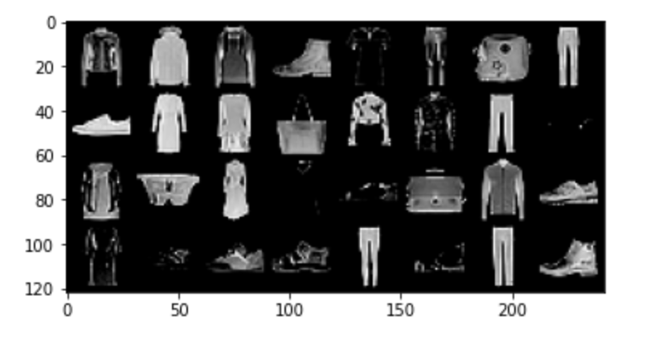
Data example
The Structure of data is 1*28*28

Slide 4
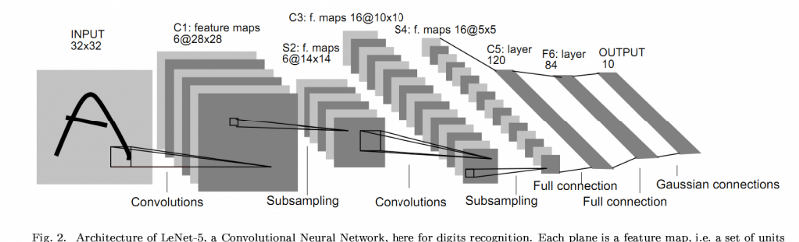
The Structure of data is 1*28*28
padding
Filter
maxpool
Filter
maxpool
Fully-connect
Padding size =2
Filter-num=6
Filter-size =(6*5*5)
Maxpool-size
=(2*2)Stride=2
Filter-num=16
Filter-size =(6*5*5)
Maxpool-size
=(2*2)Stripe=2
Fully-connect
16*5*5

Slide 5
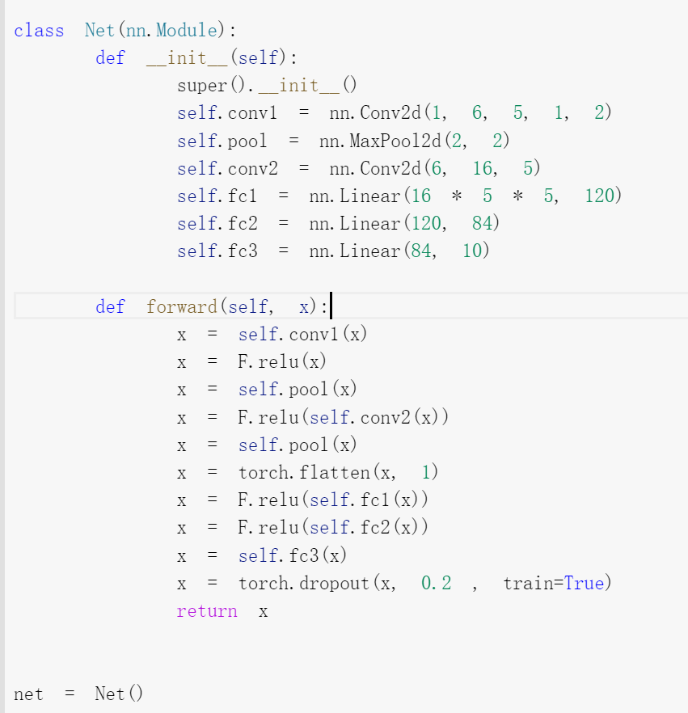
Code of this structure
Pooling size=(2*2)
Stripe =2
Active function is relu

Slide 6
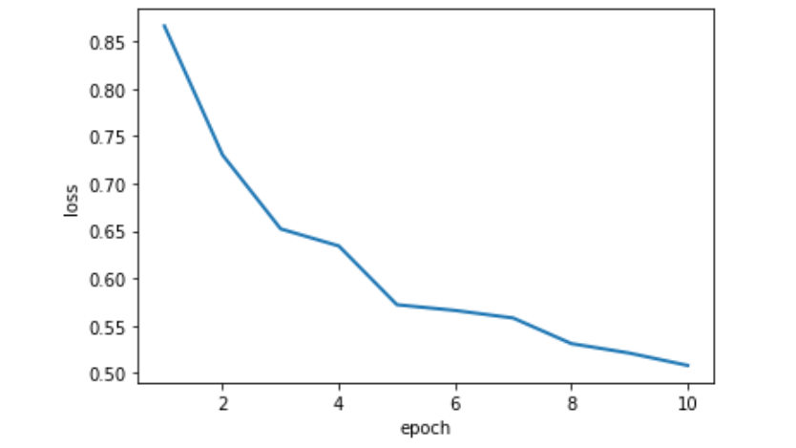
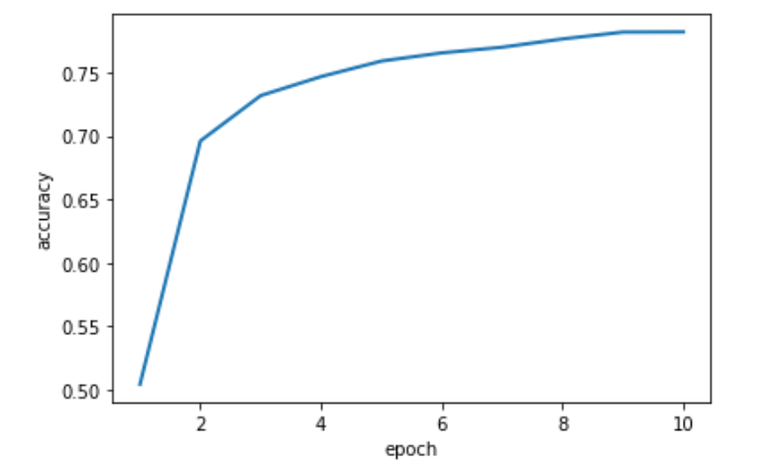
Loss-epoch graph
Accuracy-epoch graph

Slide 7
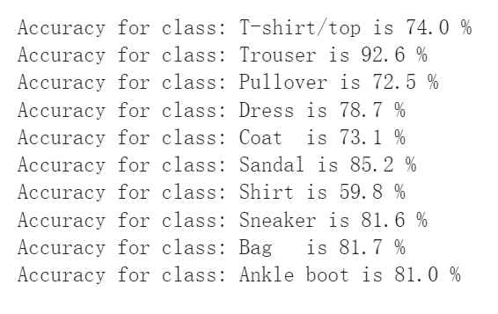
Accuracy of each class

Slide 8
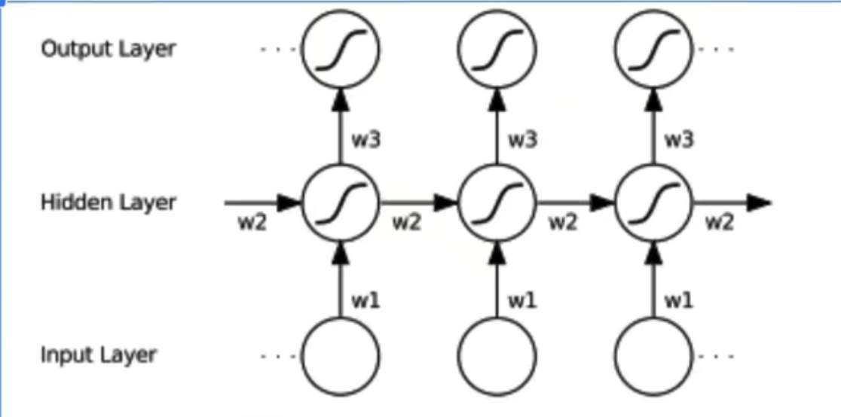
RNN structure
Activate function is 'tanh'

Slide 9
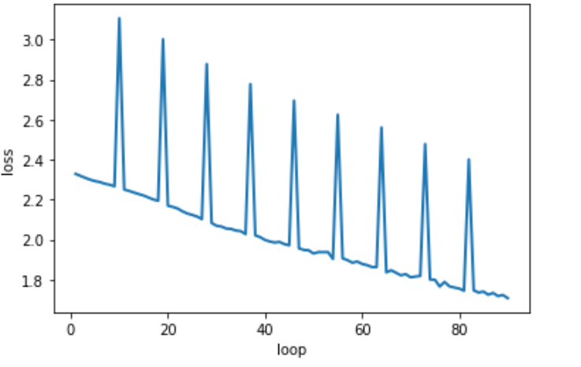
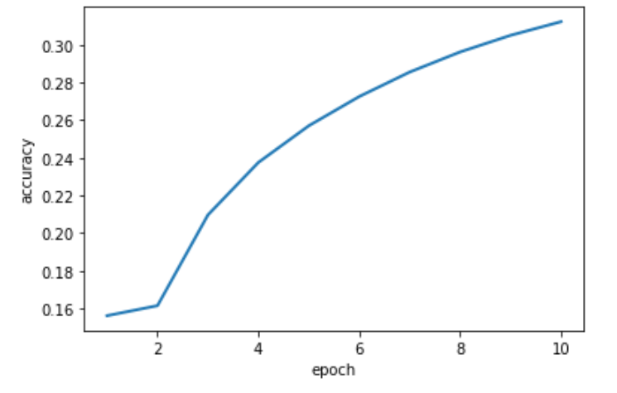
Lost –loop graph
Epoch –accuracy graph

Slide 10
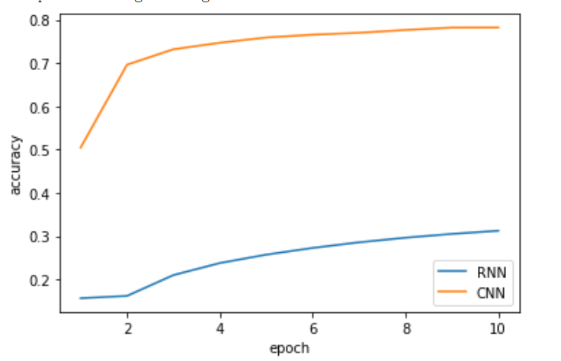
Compare RNN with CNN
The character of Recurrent Neural Network (RNN) is memory.
In this classify-version dataset, for a certain picture, it don’t have strong connect with former or behind pictures.
Through this experiment, I found that the CNN model is better than the RNN model to predict in this dataset.

Slide 11
Thanks for watching!

